Slide 1
Representations of graphs

Slide 2
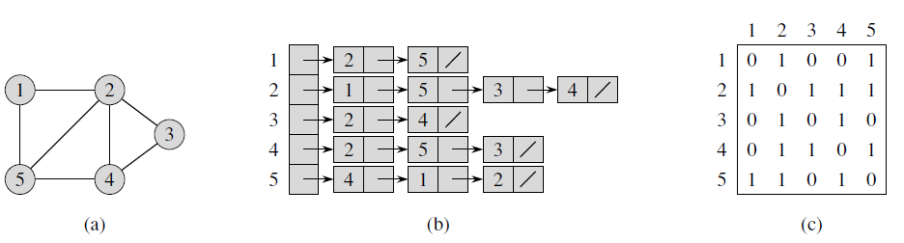
Two representations of an undirected graph

Slide 3
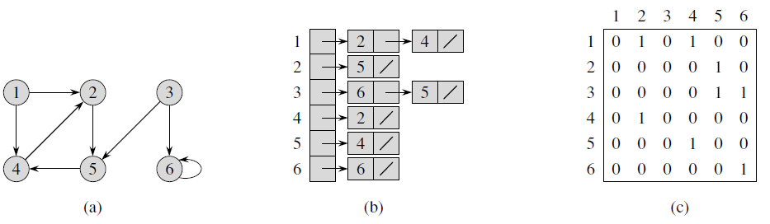
Two representations of a directed graph

Slide 4
Adjacency-list and Adjacency-matrix
The adjacency-list representation is usually preferred, because it provides a compact way to represent sparse graphs—those for which |E| is much less than |V|².
An adjacency-matrix representation may be preferred, however, when the graph is dense—|E| is close to |V|²—or when we need to be able to tell quickly if there is an edge connecting two given vertices.

Slide 5
Adjacency-list and Adjacency-matrix
If G is a directed graph, the sum of the lengths of all the adjacency lists is |E|, since an edge of the form (u, v) is represented by having v appear in Adj[u].
If G is an undirected graph, the sum of the lengths of all the adjacency lists is 2 |E|, since if (u, v) is an undirected edge, then u appears in v’s adjacency list and vice versa.

Slide 6
Adjacency-list and Adjacency-matrix
For both directed and undirected graphs, the adjacency-list representation has the desirable property that the amount of memory it requires is θ(V + E).
The adjacency matrix of a graph requires (V²) memory, independent of the number of edges in the graph.

